Slide 1
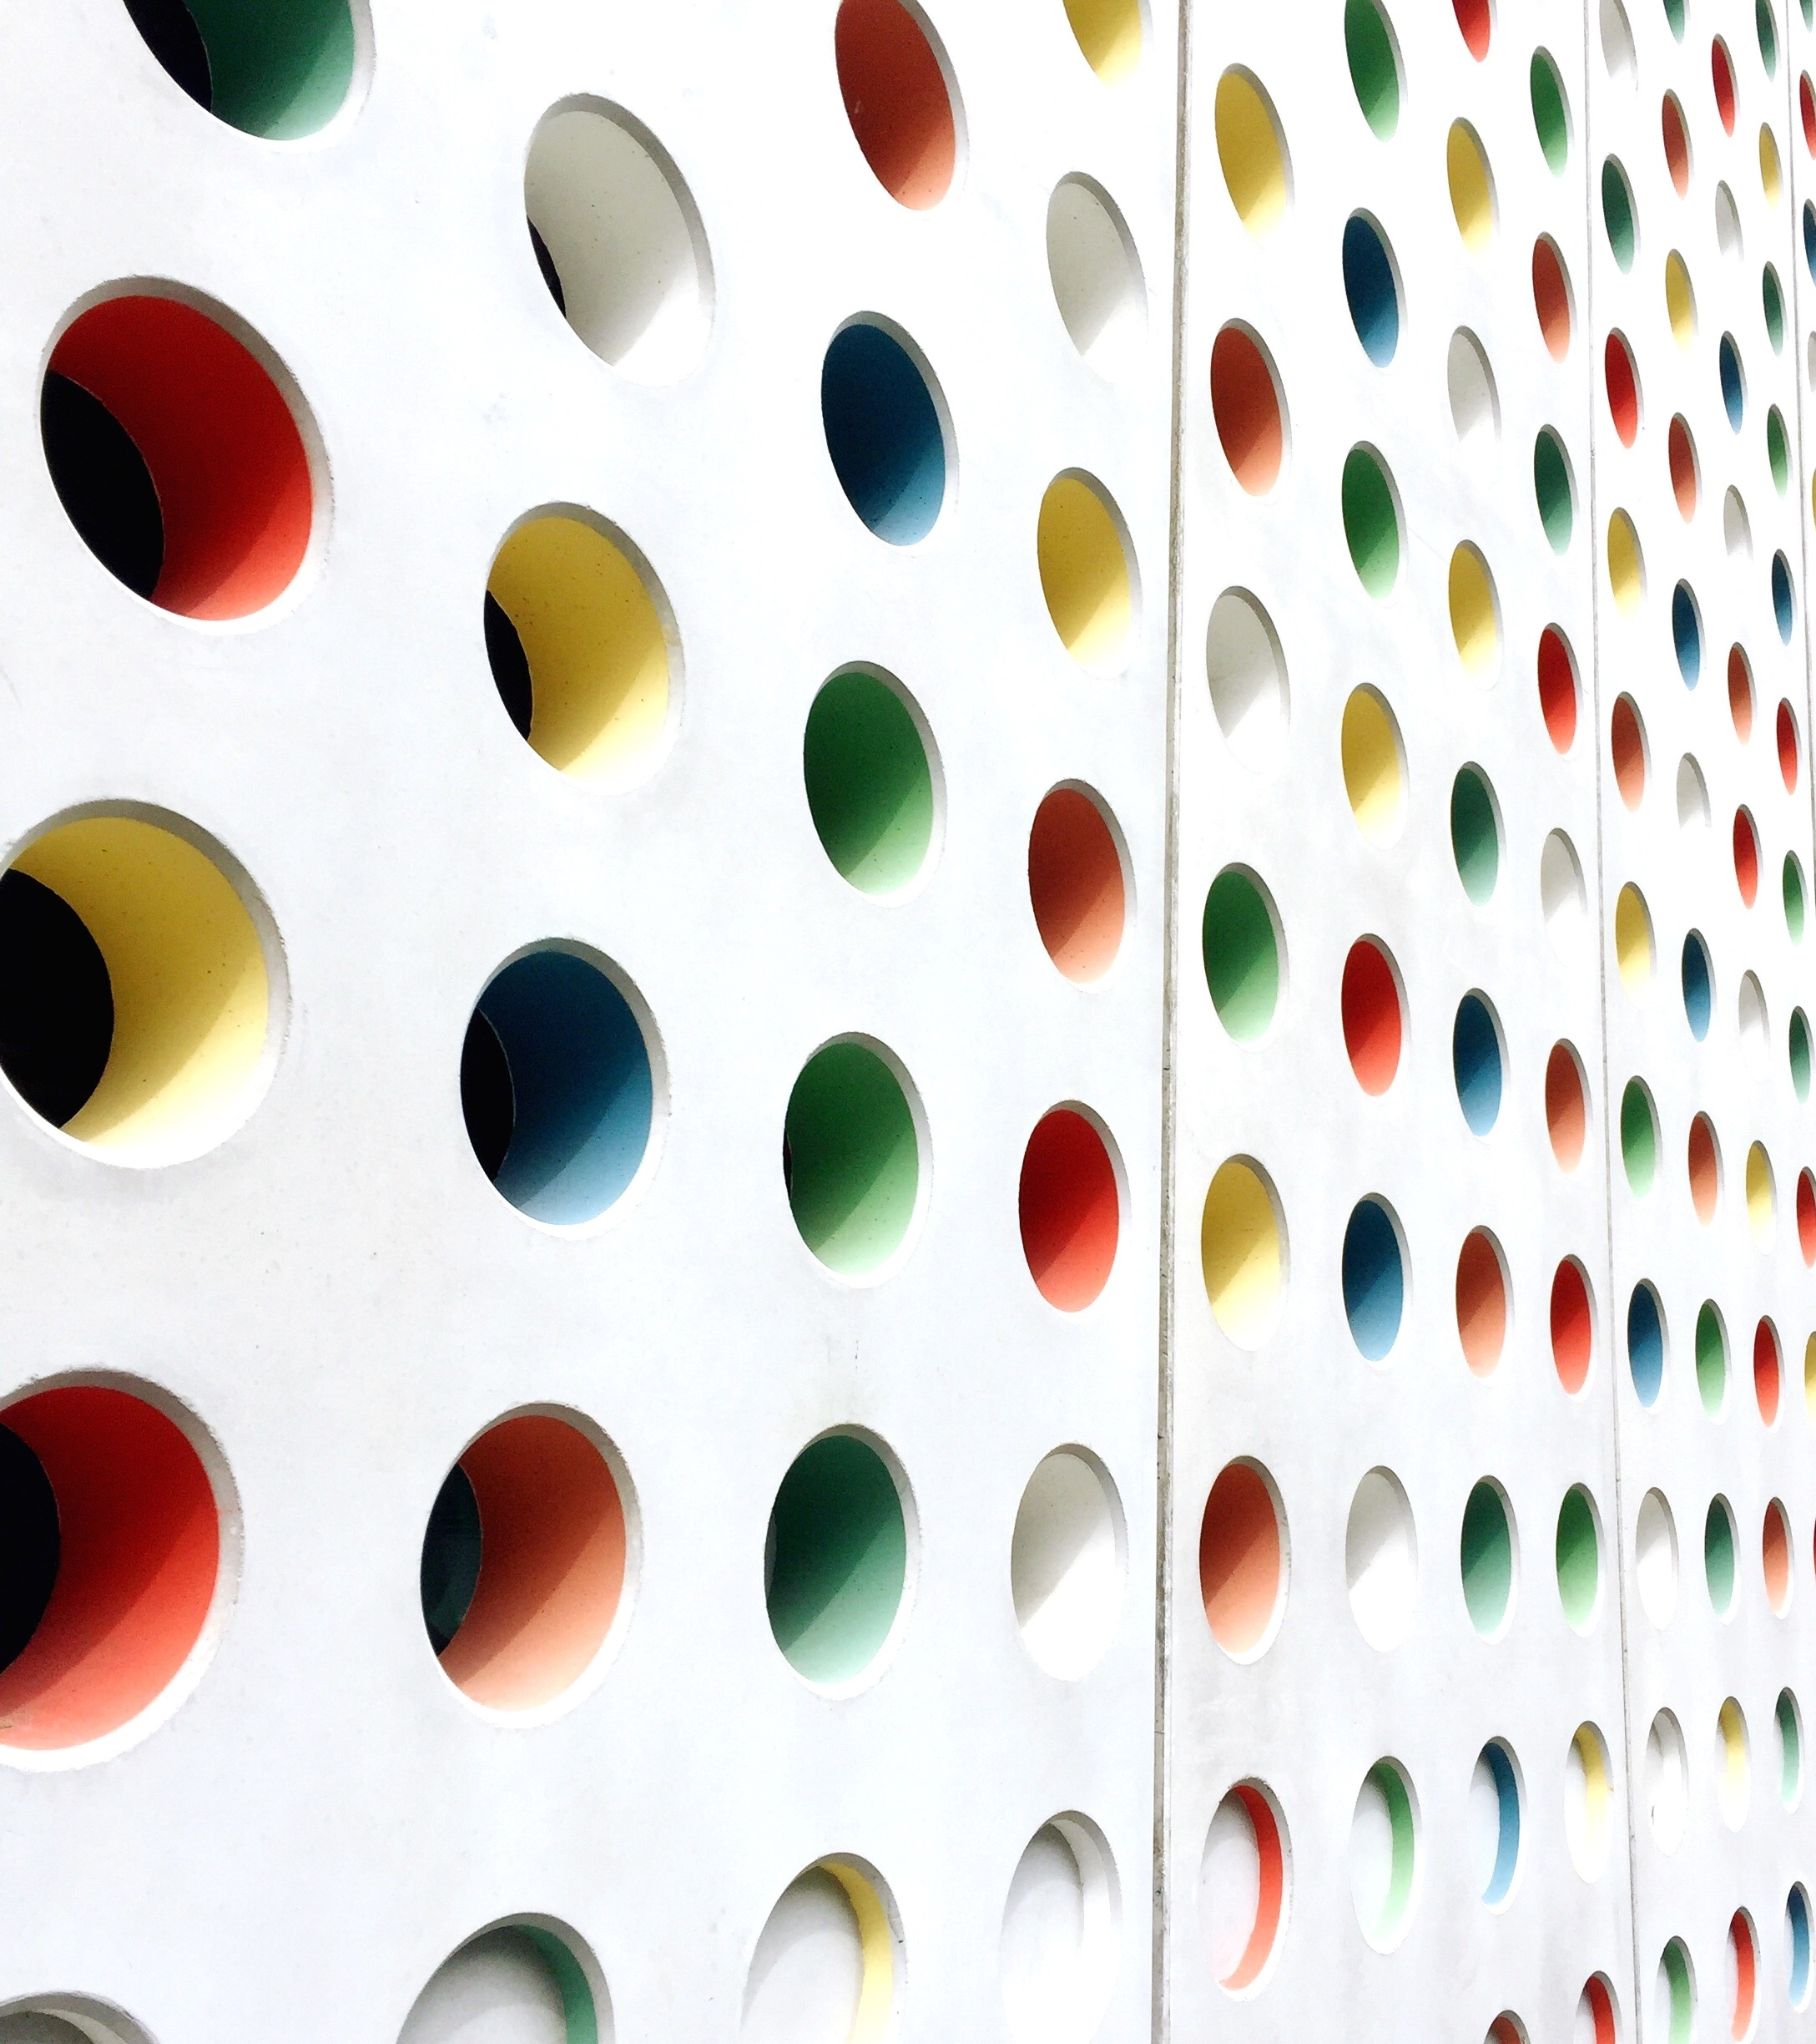


Learner’s Practice Test 1
Province of Alberta
CANADA

Slide 2
1. A Solid White lane indicates that;
A. Changing lane is permitted
B. Changing lane is permitted when the way is clear
C. Changing lane is not permitted
D. Changing lane is permitted after checking for traffic

Slide 3
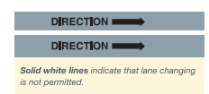
1. A Solid White lane indicates that;
A. Changing lane is permitted
B. Changing lane is permitted when the way is clear
C. Changing lane is not permitted
D. Changing lane is permitted after checking for traffic
NOTE: Driver’s guide to operation, safety and licensing (Traffic Control, Pavement markings p.39 )

Slide 4
2. What is the stopping distance of a vehicle?
A. The difference between the perception distance, the reaction distance and the braking distance of the vehicle
B. The average of the perception distance, the reaction distance and the braking distance of the vehicle
C. The product of the reaction distance to the braking distance of the vehicle
D. The sum of the perception distance, the reaction distance and the braking distance of the vehicle

Slide 5
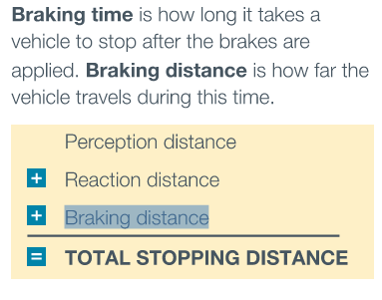
2. What is the stopping distance of a vehicle?
A. The difference between the perception distance, the reaction distance and the braking distance of the vehicle
B. The average of the perception distance, the reaction distance and the braking distance of the vehicle
C. The product of the reaction distance to the braking distance of the vehicle
D. The sum of the perception distance, the reaction distance and the braking distance of the vehicle
NOTE: Driver’s guide to operation, safety and licensing
(Basics of driving, p.50)

Slide 6
3. Type of parking most often used in parking lots
A. Hill Parking
B. Angle Parking
C. Parallel Parking
D. None of the above

Slide 7
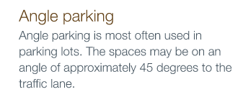
3. Type of parking most often used in parking lots
A. Hill Parking
B. Angle Parking
C. Parallel Parking
D. None of the above
NOTE: Driver’s guide to operation, safety and licensing
(Basics of driving, p.53)

Slide 8
4. When approaching to exit a roundabout or traffic circle you should;
A. Proceed without any signal indicator
B. Activate your left signal
C. Sound your horn to caution other driver’s
D. Activate your right signal

Slide 9
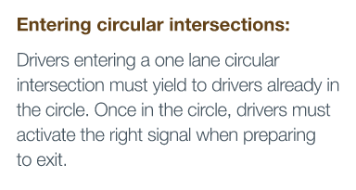
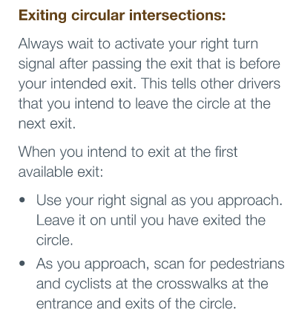
4. When approaching to exit a roundabout or traffic circle you should;
A. Proceed without any signal indicator
B. Activate your left signal
C. Sound your horn to caution other driver’s
D. Activate your right signal
NOTE: Driver’s guide to operation, safety and licensing
(Intersections and Turns, p.61)

Slide 10
5. When exiting a major roadway or highway you should;
A. Slow down after entering or turning into the deceleration lane
B. Slow down before entering or turning into the deceleration lane
C. Maintain your speed and never slowdown
D. Slow down before leaving the acceleration lane

Slide 11
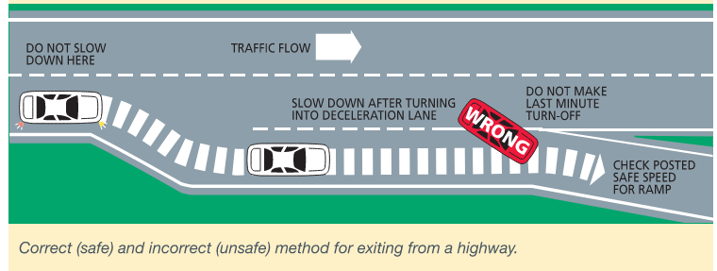
5. When exiting a major roadway or highway you should;
A. Slow down after entering or turning into the deceleration lane
B. Slow down before entering or turning into the deceleration lane
C. Maintain your speed and never slowdown
D. Slow down before leaving the acceleration lane
NOTE: Driver’s guide to operation, safety and licensing
(Highways and freeways, p.74)

Slide 12
6. A holder of class 6 operator’s license may operate which of the following vehicles?
A. A tractor-trailer
B. A taxi and limousine
C. A School bus
D. A motorcycle

Slide 13
6. A holder of class 6 operator’s license may operate which of the following vehicles?
A. A tractor-trailer
B. A taxi and limousine
C. A School bus
D. A motorcycle
NOTE: Driver’s guide to operation, safety and licensing
(Licensing information)

Slide 14
7. When another vehicle is passing you on a two-lane highway, you should
A. Slow down, activate your right signal and move slightly to the right side of your lane to allow the other driver to safely pass
B. Slow down and move slightly to the emergency lane
C. Maintain your lane and move slightly to the right side of your lane to allow other driver a better view of the road ahead
D. Move quickly to the right side of your lane

Slide 15
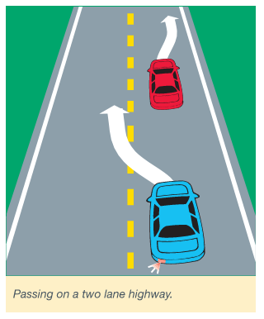
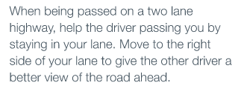
7. When another vehicle is passing you on a two-lane highway, you should
A. Slow down, activate your right signal and move slightly to the right side of your lane to allow the other driver to safely pass
B. Slow down and move slightly to the emergency lane
C. Maintain your lane and move slightly to the right side of your lane to allow other driver a better view of the road ahead
D. Move quickly to the right side of your lane
NOTE: Driver’s guide to operation, safety and licensing
(Highways and Freeways, p.72)

Slide 16
8. What should you do when you get a flat tire while driving;
A. Take your foot of the gas pedal and allow the engine to slow you down
B. Turn on your hazard and warning lights
C. Hold the steering wheel with a firm grip. Keep the vehicle on a straight course by looking and steering in the direction you want to go
D. All of the above
E. B and C only

Slide 17
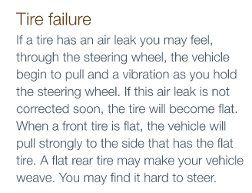
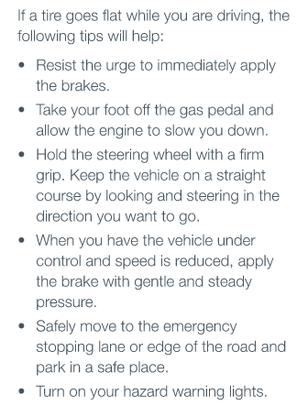
8. What should you do when you get a flat tire while driving;
A. Take your foot of the gas pedal and allow the engine to slow you down
B. Turn on your hazard and warning lights
C. Hold the steering wheel with a firm grip. Keep the vehicle on a straight course by looking and steering in the direction you want to go
D. All of the above
E. B and C only
NOTE: Driver’s guide to operation, safety and licensing
(Emergency Situations and Challenging Conditions, p.81)

Slide 18
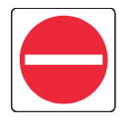
9. What does the sign indicate
A. Do not enter
B. Truck parking is allowed
C. Stop and proceed with caution
D. Only light vehicles are allowed

Slide 19
9. What does the sign indicate
A. Do not enter
B. Truck parking is allowed
C. Stop and proceed with caution
D. Only light vehicles are allowed
NOTE: Driver’s guide to operation, safety and licensing
(Traffic control, p.26) )NOTE: This would also mean WRONG WAY!)

Slide 20
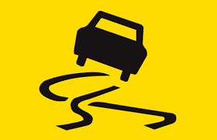
10. What does skidding mean?
A. Vehicle starts to slow down
B. Vehicle’s speed is uncontrollable
C. Vibration through the brake pedal
D. Losing control of your vehicle
E. All of the above

Slide 21
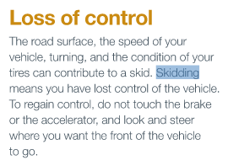
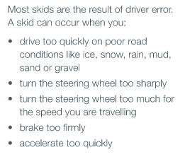
10. What does skidding mean?
A. Vehicle starts to slow down
B. Vehicle’s speed is uncontrollable
C. Vibration through the brake pedal
D. Losing control of your vehicle
E. All of the above
NOTE: Driver’s guide to operation, safety and licensing
(Emergency Situation and Challenging Conditions, p.78)

Slide 22
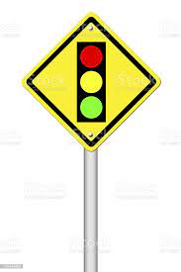
11. What does the sign mean?
A. Railway crossing ahead
B. Stop sign ahead
C. Traffic light ahead
D. Slowdown construction zone ahead

Slide 23
11. What does the sign mean?
A. Railway crossing ahead
B. Stop sign ahead
C. Traffic light ahead
D. Slowdown construction zone ahead
NOTE: Driver’s guide to operation, safety and licensing
(Traffic control, p.33)

Slide 24
12. The GDL (Graduated Driver Licensing) program aims to;
A. Improve road safety by creating a complex environment full of difficult task for new drivers
B. Improve road safety by creating a controlled and low-risk environment for new drivers
C. Improve road safety by creating an un-controlled and high-risk environment for new drivers
D. Improve road safety by providing minimal support in an un-controlled environment for new drivers

Slide 25
12. The GDL (Graduated Driver Licensing) program aims to;
A. Improve road safety by creating a complex environment full of difficult task for new drivers
B. Improve road safety by creating a controlled and low-risk environment for new drivers
C. Improve road safety by creating an un-controlled and high-risk environment for new drivers
D. Improve road safety by providing minimal support in an un-controlled environment for new drivers
NOTE: Driver’s guide to operation, safety and licensing
(Licensing information, chapter1)

Slide 26
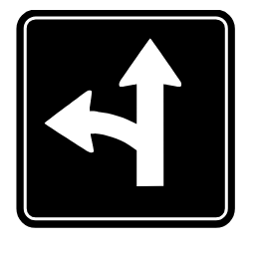
13. What does the sign mean?
A. You may turn left only
B. You may go straight or turn right
C. You may go straight or turn left
D. You may turn right only

Slide 27
13. What does the sign mean?
A. You may turn left only
B. You may go straight or turn right
C. You may go straight or turn left
D. You may turn right only
NOTE: Driver’s guide to operation, safety and licensing
(Traffic control, p.28)

Slide 28
14. Properly adjusted head restraints can greatly reduce;
A. the risk of being thrown away from the vehicle due to collisions and sudden vehicle movements
B. the risk of whiplash injuries due to collisions and sudden vehicle movement
C. collisions at railway crossings
D. All of the above

Slide 29
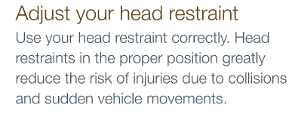
14. Properly adjusted head restraints can greatly reduce;
A. the risk of being thrown away from the vehicle due to collisions and sudden vehicle movements
B. the risk of whiplash injuries due to collisions and sudden vehicle movement
C. collisions at railway crossings
D. All of the above
NOTE: Driver’s guide to operation, safety and licensing
(The basics of driving, p.45)

Slide 30
15. Turning right from a two-way road onto another two-way road, you should;
A. Turn into the left lane
B. Swing wide to the left and turn to your lane
C. Stay centered into your turning lane, and no more that one meter from the curb or edge of the road
D. All of the above

Slide 31
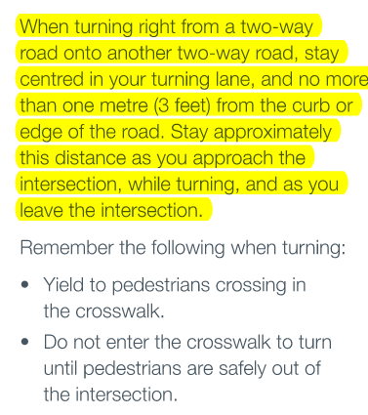
15. Turning right from a two-way road onto another two-way road, you should;
A. Turn into the left lane
B. Swing wide to the left and turn to your lane
C. Stay centered into your turning lane, and no more that one meter from the curb or edge of the road
D. All of the above
NOTE: Driver’s guide to operation, safety and licensing
(Intersections and turns, p.64)

Slide 32
16. If you see a red “X” above your lane, you should;
A. You may remain driving in that lane
B. Drive with caution and watch for on-coming traffic
C. Move safely into a lane with a green arrow
D. Slow down for pedestrians

Slide 33
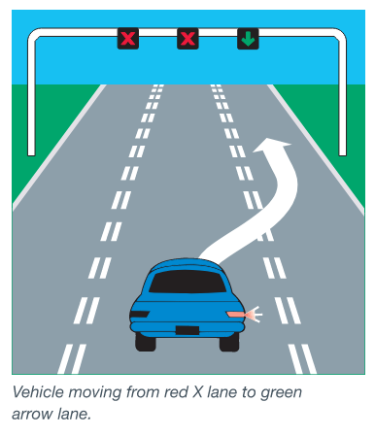
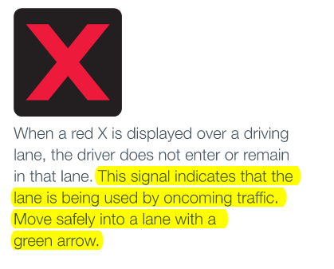
16. If you see a red “X” above your lane, you should;
A. You may remain driving in that lane
B. Drive with caution and watch for on-coming traffic
C. Move safely into a lane with a green arrow
D. Slow down for pedestrians
NOTE: Driver’s guide to operation, safety and licensing
(Traffic control, p.24-25)

Slide 34
17. U-turns are permitted at which of the following locations in an urban area?
A. On a roadway between intersections
B. At an alley intersection
C. At an intersection where one or more of the roadways is an access to a public or private parking lot which public can access
D. None of the above

Slide 35
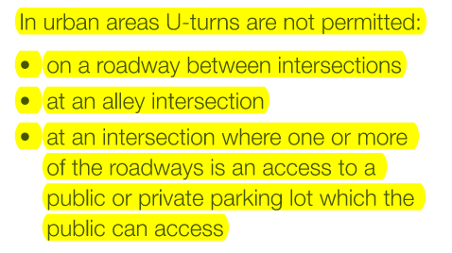
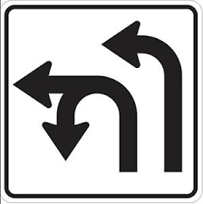
17. U-turns are permitted at which of the following locations in an urban area?
A. On a roadway between intersections
B. At an alley intersection
C. At an intersection where one or more of the roadways is an access to a public or private parking lot which public can access
D. None of the above
NOTE: Driver’s guide to operation, safety and licensing
(Intersections and turns, p.67)
> U-turns are allowed only at areas where a sign indicates that U-turns are permitted

Slide 36
18. To obtain a class 7 learner’s driving license you must?
A. Have a parental consent if you are under 18 years of age
B. be 16 years of age or older
C. pass the basic Alberta class 5 road test
D. pass the knowledge test on the rules of the road
E. A and D is correct

Slide 37
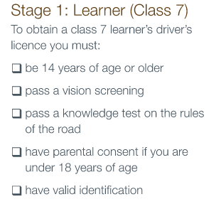
18. To obtain a class 7 learner’s driving license you must?
A. Have a parental consent if you are under 18 years of age
B. be 16 years of age or older
C. pass the basic Alberta class 5 road test
D. pass the knowledge test on the rules of the road
E. A and D are correct
NOTE: Driver’s guide to operation, safety and licensing
(Licensing information, p.10)

Slide 38
19. The shoulder of a highway is intended for
A. passing vehicles
B. Emergencies
C. bicyclist
D. commercial vehicles

Slide 39
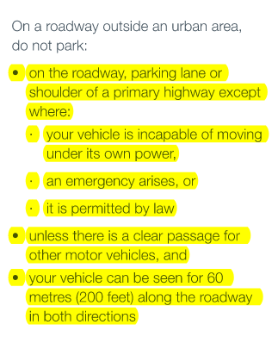
19. The shoulder of a highway is intended for
A. passing vehicles
B. Emergencies
C. bicyclist
D. commercial vehicles
NOTE: Driver’s guide to operation, safety and licensing
(The basics of driving, p.56)

Slide 40

20. What does the sign mean?
A. Divider ahead – keep right
B. Straight only
C. Divided highway begins
D. Narrow passage

Slide 41
20. What does the sign mean?
A. Divider ahead – keep right
B. Straight only
C. Divided highway begins
D. Narrow passage
NOTE: Driver’s guide to operation, safety and licensing
(Traffic control, p.27)

Slide 42
21. When you are driving behind another vehicle under normal conditions, you should;
A. maintain a maximum four second following distance
B. maintain a maximum three second following distance
C. maintain a maximum six second following distance
D. maintain a maximum two second following distance

Slide 43
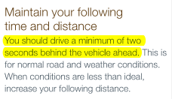
21. When you are driving behind another vehicle under normal conditions, you should;
A. maintain a maximum four second following distance
B. maintain a maximum three second following distance
C. maintain a maximum six second following distance
D. maintain a maximum two second following distance
NOTE: Driver’s guide to operation, safety and licensing
(Responsible driving, p.91)

Slide 44
22. Flashing amber and red lights means;
A. Emergency vehicle
B. Railway crossing ahead
C. Snowplow ahead
D. Detour ahead

Slide 45
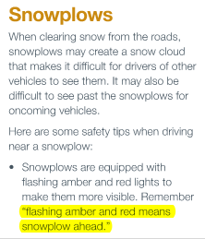
22. Flashing amber and red lights means;
A. Emergency vehicle
B. Railway crossing ahead
C. Snowplow ahead
D. Detour ahead
NOTE: Driver’s guide to operation, safety and licensing
(Sharing the road, p.103)

Slide 46
23. You must activate your signal lights when you are;
A. moving away from the curb or parking lane
B. changing lanes
C. turning left or right
D. All of the above

Slide 47
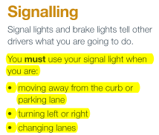
23. You must activate your signal lights when you are;
A. moving away from the curb or parking lane
B. changing lanes
C. turning left or right
D. All of the above
NOTE: Driver’s guide to operation, safety and licensing
(The basics of driving, p.49)

Slide 48
24. A broken yellow line on your side of the road indicates that;
A. Passing is not permitted
B. Passing is permitted when your way is clear and can be completed safely
C. Changing lane is not permitted
D. None of the above

Slide 49
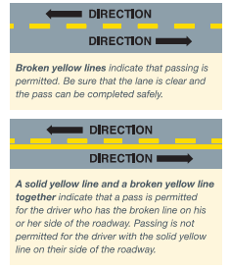
24. A broken yellow line on your side of the road indicates that;
A. Passing is not permitted
B. Passing is permitted when your way is clear and can be completed safely
C. Changing lane is not permitted
D. None of the above
NOTE: Driver’s guide to operation, safety and licensing
(Traffic control, p.38)

Slide 50
25. ABS (Anti-lock braking system) in vehicles assist driver’s in performing;
A. Emergency stops
B. Emergency right turns
C. Emergency left turns
D. Emergency repairs

Slide 51
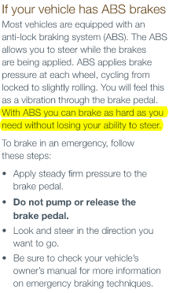
25. ABS (Anti-lock braking system) in vehicles assist driver’s in performing;
A. Emergency stops
B. Emergency right turns
C. Emergency left turns
D. Emergency repairs
NOTE: Driver’s guide to operation, safety and licensing
(Emergency situations and challenging conditions, p.78)

Slide 52
26. What is the correct hand signal for slowing or stopping?
A. Left hand out the window and pointing upward
B. Left hand pointing straight out the window
C. Left hand out the window and pointing forward
D. Left hand out the window and pointing downward

Slide 53
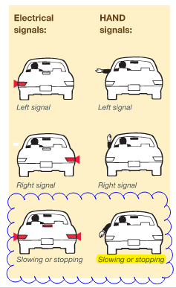
26. What is the correct hand signal for slowing or stopping?
A. Left hand out the window and pointing upward
B. Left hand pointing straight out the window
C. Left hand out the window and pointing forward
D. Left hand out the window and pointing downward
NOTE: Driver’s guide to operation, safety and licensing
(The basics of driving, p.49)

Slide 54
27. Under Alberta law, cyclist under 18 years of age must wear?
A. an approved safety helmet
B. an approved eye protection
C. approved protective clothing
D. All of the above

Slide 55
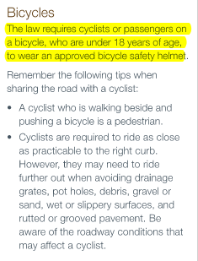
27. Under Alberta law, cyclist under 18 years of age must wear?
A. an approved safety helmet
B. an approved eye protection
C. approved protective clothing
D. All of the above
NOTE: Driver’s guide to operation, safety and licensing
(Sharing the road, p.98)

Slide 56
28. A white or clear lights at the rear of a vehicle indicates that;
A. the vehicle is parked
B. the vehicle is stopping
C. the vehicle is in an emergency
D. the vehicle is in reverse

Slide 57
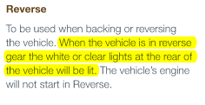
28. A white or clear lights at the rear of a vehicle indicates that;
A. the vehicle is parked
B. the vehicle is stopping
C. the vehicle is in an emergency
D. the vehicle is in reverse
NOTE: Driver’s guide to operation, safety and licensing
(The basics of driving, p.46)

Slide 58
29. Areas that you cannot see other road user’s in your mirror are called?
A. invisible spot
B. zero visibility
C. no-spots
D. blind spots

Slide 59
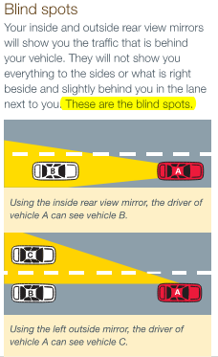
29. Areas that you cannot see other road user’s in your mirror are called?
A. invisible spot
B. zero visibility
C. no-spots
D. blind spots
NOTE: Driver’s guide to operation, safety and licensing
(Highways and freeways, p.70)

Slide 60
30. Before entering your vehicle walk around to check for?
A. adult pedestrians
B. children and Pets
C. proper tire inflation
D. all of the above

Slide 61
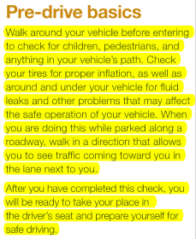
30. Before entering your vehicle walk around to check for?
A. adult pedestrians
B. children and Pets
C. proper tire inflation
D. all of the above
NOTE: Driver’s guide to operation, safety and licensing
(The basics of driving, p.44)

Slide 62
THANK YOU VERY MUCH AND GOOD LUCK!
If you like this video you might want to consider to subscribing to this channel for more videos to come…

