Slide 1
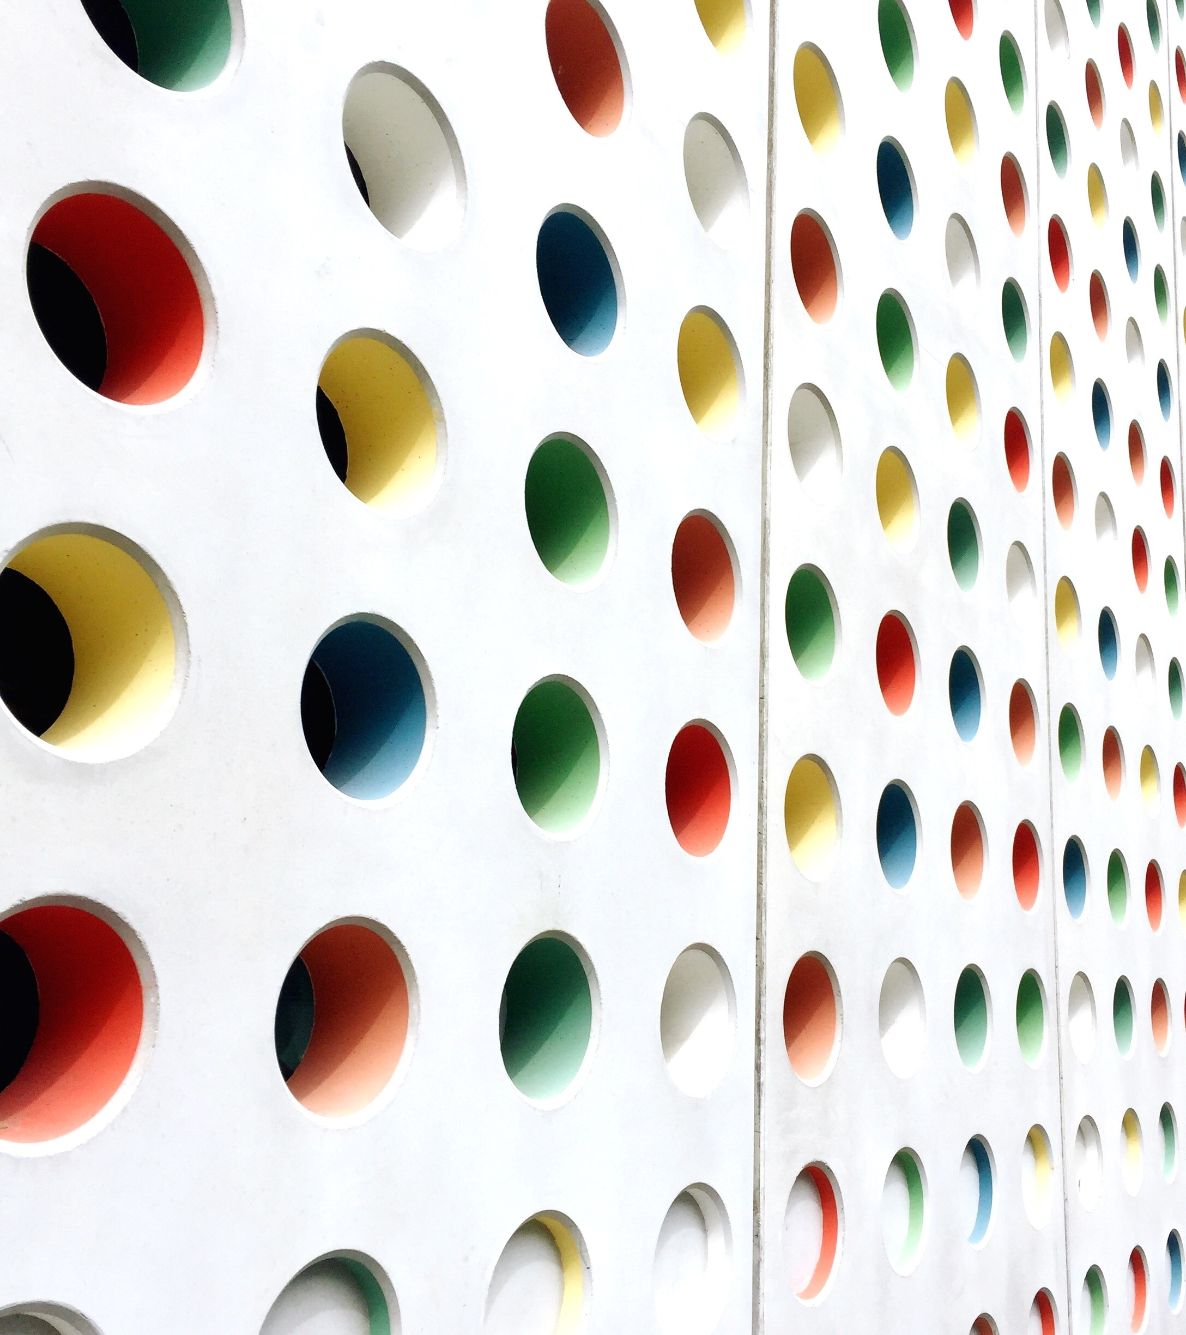

Learner’s Practice Test 2
Province of Alberta
CANADA

Slide 2
1. A vehicle with flashing amber and red lights is most likely which of the following?
A. A snowplow
B. A tractor-trailer
C. An emergency vehicle
D. A tow truck

Slide 3
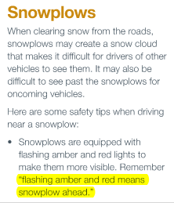
1. A vehicle with flashing amber and red lights is most likely which of the following?
A. A snowplow
B. A tractor-trailer
C. An emergency vehicle
D. A tow truck
NOTE: Driver’s guide to operation, safety and licensing
(Sharing the road, p.103)

Slide 4
2. Areas where the highway entrance and exit use the same lane are called?
A. merge zones
B. safety zones
C. emergency zones
D. weave zones

Slide 5
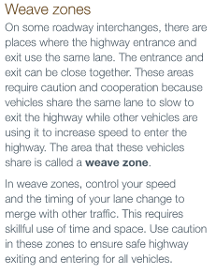
2. Areas where the highway entrance and exit use the same lane are called?
A. merge zones
B. safety zones
C. emergency zones
D. weave zones
NOTE: Driver’s guide to operation, safety and licensing
(highway and freeways, p.74)

Slide 6
3. Upon entering an acceleration lane before merging with highway traffic, you should NOT
A. signal your intention to merge
B. slow down or stop
C. accelerate or increase your speed
D. Check your mirrors

Slide 7
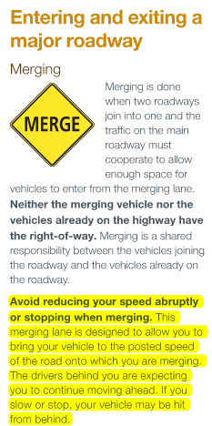
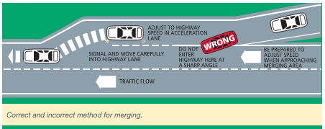
3. Upon entering an acceleration lane before merging with highway traffic, you should NOT
A. signal your intention to merge
B. slow down or stop
C. accelerate or increase your speed
D. Check your mirrors
NOTE: Driver’s guide to operation, safety and licensing
(highways and freeways, p.73)

Slide 8
4. In a two-lane roundabout or traffic circle, when you intend to leave past the first exit you should;
A. Approach the circle using the right lane
B. Approach the circle using either lane
C. Approach the circle using the faster lane
D. Approach the circle using the left lane

Slide 9
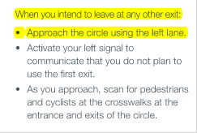
4. In a two-lane roundabout or traffic circle, when you intend to leave past the first exit you should;
A. Approach the circle using the right lane
B. Approach the circle using either lane
C. Approach the circle using the faster lane
D. Approach the circle using the left lane
NOTE: Driver’s guide to operation, safety and licensing
(Intersections and Turns, p.63)

Slide 10
5. If you need to brake hard in an emergency with your vehicle equipped with ABS (anti-lock braking system), you should;
A. apply steady firm pressure to the brake pedal
B. Pump or release the brake pedal
C. apply steady light pressure to the brake pedal
D. Shift to neutral and steer your vehicle to the right

Slide 11
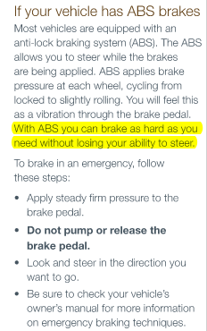
5. If you need to brake hard in an emergency with your vehicle equipped with ABS (anti-lock braking system), you should;
A. apply steady firm pressure to the brake pedal
B. Pump or release the brake pedal
C. apply steady light pressure to the brake pedal
D. Shift to neutral and steer your vehicle to the right
NOTE: Driver’s guide to operation, safety and licensing
(Emergency Situations and Challenging Conditions, p.78)

Slide 12
6. Under inflated tires may cause to
A. increase in fuel consumption
B. reduce tire traction
C. increase tire wear
D. All of the above

Slide 13
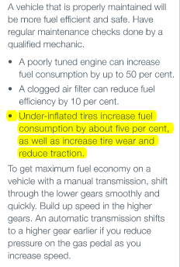
6. Under inflated tires may cause to
A. increase in fuel consumption
B. reduce tire traction
C. increase tire wear
D. All of the above
NOTE: Driver’s guide to operation, safety and licensing
(Responsible driving, p.94)

Slide 14

7. What does this sign mean?
A. Bump ahead
B. Pavement ends ahead
C. Falling rocks ahead
D. Danger zone ahead

Slide 15
7. What does this sign mean?
A. Bump ahead
B. Pavement ends ahead
C. Falling rocks ahead
D. Danger zone ahead
NOTE: Driver’s guide to operation, safety and licensing
(Traffic control, p.35)

Slide 16
8. A person 75 years of age or older must submit/satisfy which of the following to renew their driver’s license?
A. Submit proof of residency and medical report
B. Submit proof of age, medical report and proof of residency
C. Submit proof of age and residency
D. Submit a medical report and undergo a vision screening

Slide 17
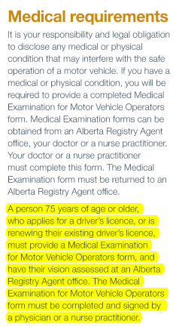
8. A person 75 years of age or older must submit/satisfy which of the following to renew their driver’s license?
A. Submit proof of residency and medical report
B. Submit proof of age, medical report and proof of residency
C. Submit proof of age and residency
D. Submit a medical report and undergo a vision screening
NOTE: Driver’s guide to operation, safety and licensing
(Licensing Information, p.17)

Slide 18
9. What should you NOT do when you see a flag person
A. Obey the flag person’s signal
B. Be prepared to slow down and stop if required
C. Increase your speed and pass quickly if possible
D. None of the above

Slide 19
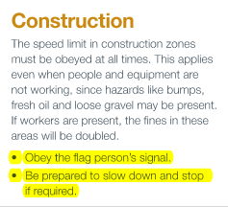

9. What should you NOT do when you see a flag person
A. Obey the flag person’s signal
B. Be prepared to slow down and stop if required
C. Increase your speed and pass quickly if possible
D. None of the above
NOTE: Driver’s guide to operation, safety and licensing
(Traffic control, p.37)

Slide 20
10. When pedestrians indicate their intention to cross the street, you must;
A. Slow down and proceed when safe to do so
B. Increase your speed and honk your horn to alert the pedestrian
C. Honk your horn before the crosswalk because you have the right of way
D. Stop your vehicle safely before the crosswalk and allow them to cross

Slide 21
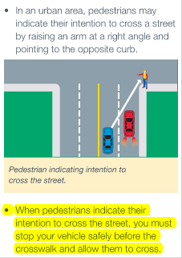
10. When pedestrians indicate their intention to cross the street, you must;
A. Slow down and proceed when safe to do so
B. Increase your speed and honk your horn to alert the pedestrian
C. Honk your horn before the crosswalk because you have the right of way
D. Stop your vehicle safely before the crosswalk and allow them to cross
NOTE: Driver’s guide to operation, safety and licensing
(Sharing the road, p.98)

Slide 22
11. If you miss your exit, you must
A. Stop
B. Reverse to the emergency stopping lane or shoulder
C. Continue to the next exit and make plans to return your route
D. All of the above

Slide 23
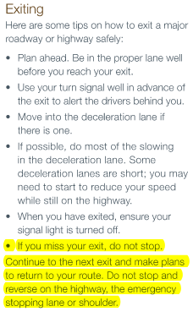
11. If you miss your exit, you must
A. Stop
B. Reverse to the emergency stopping lane or shoulder
C. Continue to the next exit and make plans to return your route
D. All of the above
NOTE: Driver’s guide to operation, safety and licensing
(Highways and freeways, p.74)

Slide 24
12. What should you do when you see a train sounding a signal and approaching within 500 metres?
A. take a detour
B. Stop and wait for the train to pass
C. Make a U-turn
D. Proceed and quickly cross the intersection

Slide 25
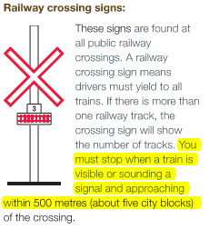
12. What should you do when you see a train sounding a signal and approaching within 500 metres?
A. take a detour
B. Stop and wait for the train to pass
C. Make a U-turn
D. Proceed and quickly cross the intersection
NOTE: Driver’s guide to operation, safety and licensing
(sharing the road, p.104)

Slide 26
13. Which of the following statement about vehicle insurance is NOT true?
A. All motor vehicles must be insured with a public liability insurance policy as outlined in the Alberta Insurance act
B. It is illegal to operate an uninsured motor vehicle
C. Only commercial vehicles must be insured with a public liability insurance policy
D. Financial responsibility card (pink card) must be presented when requested by a peace officer

Slide 27
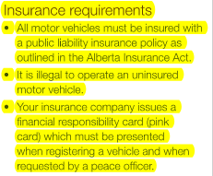
13. Which of the following statement about vehicle insurance is NOT true?
A. All motor vehicles must be insured with a public liability insurance policy as outlined in the Alberta Insurance act
B. It is illegal to operate an uninsured motor vehicle
C. Only commercial vehicles must be insured with a public liability insurance policy
D. Financial responsibility card (pink card) must be presented when
requested by a peace officer
NOTE: Driver’s guide to operation, safety and licensing
(Licensing Information, p.20)

Slide 28
14. Space between yourself and the vehicle ahead, behind you and to either side of you, is called?
A. Visual Space
B. Space Cushion
C. Safe Cushion
D. Hazard Space

Slide 29
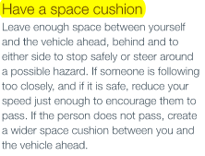
14. Space between yourself and the vehicle ahead, behind you and to either side of you, is called?
A. Visual Space
B. Space Cushion
C. Safe Cushion
D. Hazard Space
NOTE: Driver’s guide to operation, safety and licensing
(Responsible Driving, p.90)

Slide 30
15. On a multi-lane highway, slower traffic should travel in the
A. middle lane
B. lane furthest to the left
C. lane furthest to the right
D. Emergency lane

Slide 31
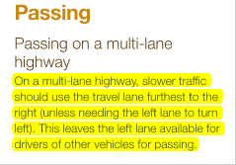
15. On a multi-lane highway, slower traffic should travel in the
A. middle lane
B. lane furthest to the left
C. lane furthest to the right
D. Emergency lane
NOTE: Driver’s guide to operation, safety and licensing
(Highways and Freeways, p.71)

Slide 32
16. Be cautious of large vehicle backing because
A. Large vehicles do not have rear mirrors
B. Large vehicles may roll back when the driver releases the brakes
C. Large vehicles have large blind spots and may not be able to see you in the rear view mirrors
D. Large vehicles are long and may pull more than one trailer

Slide 33

16. Be cautious of large vehicle backing because
A. Large vehicles do not have rear mirrors
B. Large vehicles may roll back when the driver releases the brakes
C. Large vehicles have large blind spots and may not be able to see you in the rear view mirrors
D. Large vehicles are long and may pull more than one trailer
NOTE: Driver’s guide to operation, safety and licensing
(Sharing the road, p.100)

Slide 34
17. Do not follow too closely behind cyclist because
A. they do not have signal lights
B. they can be hard to see
C. it is difficult to judge their speed
D. they do not have brake lights to warn you when they are stopping

Slide 35
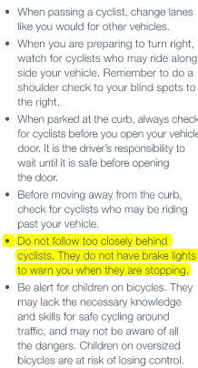
17. Do not follow too closely behind cyclist because
A. they do not have signal lights
B. they can be hard to see
C. it is difficult to judge their speed
D. they do not have brake lights to warn you when they are stopping
NOTE: Driver’s guide to operation, safety and licensing
(Sharing the road, p.99)

Slide 36
18. If you are involve in a collision, you are requiredto report to the police or local enforcement if:
A. anyone has been injured
B. anyone has been killed
C. overall damage exceeds $2,000
D. All of the above
E. A and B only are correct

Slide 37
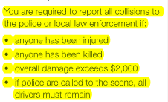
18. If you are involve in a collision, you are requiredto report to the police or local enforcement if:
A. anyone has been injured
B. anyone has been killed
C. overall damage exceeds $2,000
D. All of the above
E. A and B only are correct
NOTE: Driver’s guide to operation, safety and licensing
(Emergency Situations and Challenging Conditions, p.84)

Slide 38
19. For any damages less than $2,000, you must report this to the police if:
A. you damage any traffic control device
B. you damage a parking meter
C. you damage a public property
D. All of the above
E. none of the above, you are only required to report for damages over $2,000

Slide 39

19. For any damages less than $2,000, you must report this to the police if:
A. you damage any traffic control device
B. you damage a parking meter
C. you damage a public property
D. All of the above
E. none of the above, you are only required to report for damages over $2,000
NOTE: Driver’s guide to operation, safety and licensing
(Emergency Situations and Challenging Conditions, p.84)

Slide 40

20. What does the sign mean?
A. Crawl stop and proceed when they way is clear
B. Slow down and proceed when safe
C. Come to a complete stop and do not proceed until safe
D. Yield to all road users and proceed when safe

Slide 41
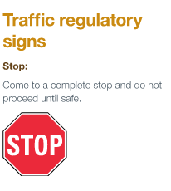
20. What does the sign mean?
A. Crawl stop and proceed when they way is clear
B. Slow down and proceed when safe
C. Come to a complete stop and do not proceed until safe
D. Yield to all road users and proceed when safe
NOTE: Driver’s guide to operation, safety and licensing
(Traffic control, p.26)

Slide 42
21. What is the maximum speed limit on a provincial highway located outside an urban area?
A. 80 km/h
B. 90 km/h
C. 110 km/h
D. 100 km/h

Slide 43

21. What is the maximum speed limit on a provincial highway located outside an urban area?
A. 80 km/h
B. 90 km/h
C. 110 km/h
D. 100 km/h
NOTE: Driver’s guide to operation, safety and licensing
(Traffic Control, p.27)

Slide 44
22. To obtain a class 7 learner’s driver’s license you must be 14 years of age or older
A. TRUE
B. FALSE

Slide 45
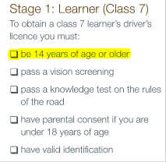
22. To obtain a class 7 learner’s driver’s license you must be 14 years of age or older
A. TRUE
B. FALSE
NOTE: Driver’s guide to operation, safety and licensing
(Licensing Information, p.10)

Slide 46
23. From the following conditions, what is NOT common for class 7 and class 5-GDL licenses:
A. You will be suspended if you accumulate eight or more demerit points
B. You must have a zero level of alcohol when driving
C. You are not permitted to have more passengers than seat belts
D. You are not permitted to drive from midnight to 5 a.m.

Slide 47
23. From the following conditions, what is NOT common for class 7 and class 5-GDL licenses:
A. You will be suspended if you accumulate eight or more demerit points
B. You must have a zero level of alcohol when driving
C. You are not permitted to have more passengers than seat belts
D. You are not permitted to drive from midnight to 5 a.m.
NOTE: Driver’s guide to operation, safety and licensing
(Licensing Information, p.10)

Slide 48
24. You will be given 6 demerit points for:
A. Careless driving
B. Failing to stop for a school bus
C. Racing
D. All of the above

Slide 49

24. You will be given 6 demerit points for:
A. Careless driving
B. Failing to stop for a school bus
C. Racing
D. All of the above
NOTE: Driver’s guide to operation, safety and licensing
(Driving within the Law, p.110)

Slide 50
25. What is the minimum years to complete both the learner’s and probationary of the GDL program
A. 1 years
B. 2 years
C. 3 years
D. 4 years

Slide 51

25. What is the minimum years to complete both the learner’s and probationary of the GDL program
A. 1 years
B. 2 years
C. 3 years
D. 4 years
NOTE: Driver’s guide to operation, safety and licensing
(Licensing information, p.10)

Slide 52
26. What is the minimum licensing age for class 5 – GDL?
A. 14
B. 15
C. 16
D. 18

Slide 53
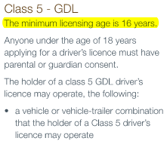
26. What is the minimum licensing age for class 5 – GDL?
A. 14
B. 15
C. 16
D. 18
NOTE: Driver’s guide to operation, safety and licensing
(Licensing Information, p.14)

Slide 54
27. What does a code Q on your license mean?
A. you have an air brake endorsement
B. you have completed driver education course
C. School bus endorsement
D. you have special conditions

Slide 55
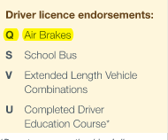
27. What does a code Q on your license mean?
A. you have an air brake endorsement
B. you have completed driver education course
C. School bus endorsement
D. you have special conditions
NOTE: Driver’s guide to operation, safety and licensing
(Licensing Information, p.19)

Slide 56
28. What does a flashing yellow light mean?
A. Slow down and proceed when safe
B. Proceed with caution
C. Stop and proceed with caution
D. Yield to all road users and proceed when safe

Slide 57
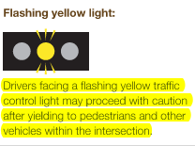
28. What does a flashing yellow light mean?
A. Slow down and proceed when safe
B. Proceed with caution
C. Stop and proceed with caution
D. Yield to all road users and proceed when safe
NOTE: Driver’s guide to operation, safety and licensing
(Traffic Control, p.23)

Slide 58
29. What is the maximum speed limit on a roadway that is located outside an urban area?
A. 70 km/h
B. 80 km/h
C. 90 km/h
D. 100 km/h

Slide 59

29. What is the maximum speed limit on a roadway that is located outside an urban area?
A. 70 km/h
B. 80 km/h
C. 90 km/h
D. 100 km/h
NOTE: Driver’s guide to operation, safety and licensing
(Traffic Control, p.27)

Slide 60

30. What does the sign mean?
A. Reserved lane for taxis
B. Reserved lane for buses
C. Reserved lane for bicycles
D. Reserved lane for limousines

Slide 61
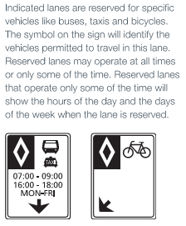
30. What does the sign mean?
A. Reserved lane for taxis
B. Reserved lane for buses
C. Reserved lane for bicycles
D. Reserved lane for limousines
NOTE: Driver’s guide to operation, safety and licensing
(Traffic Control, p.28)

